Slide 1


Slide 2
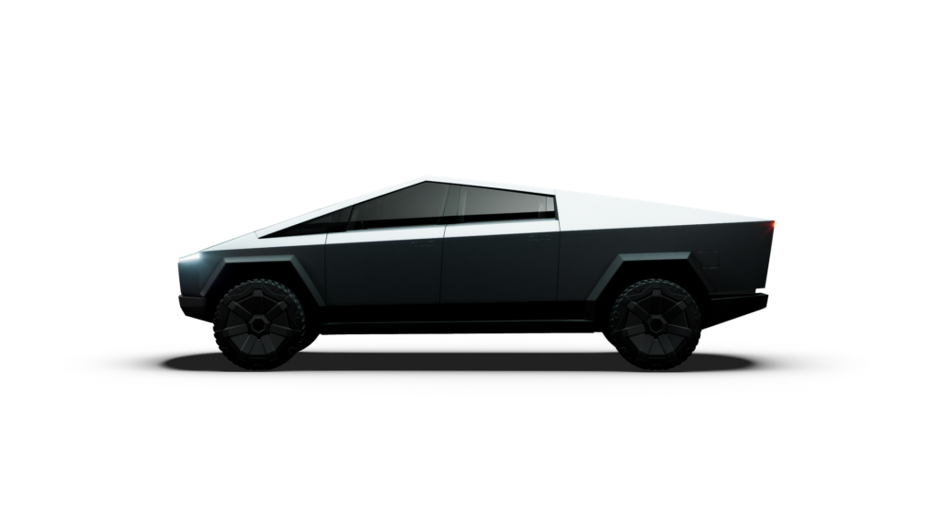

Slide 3
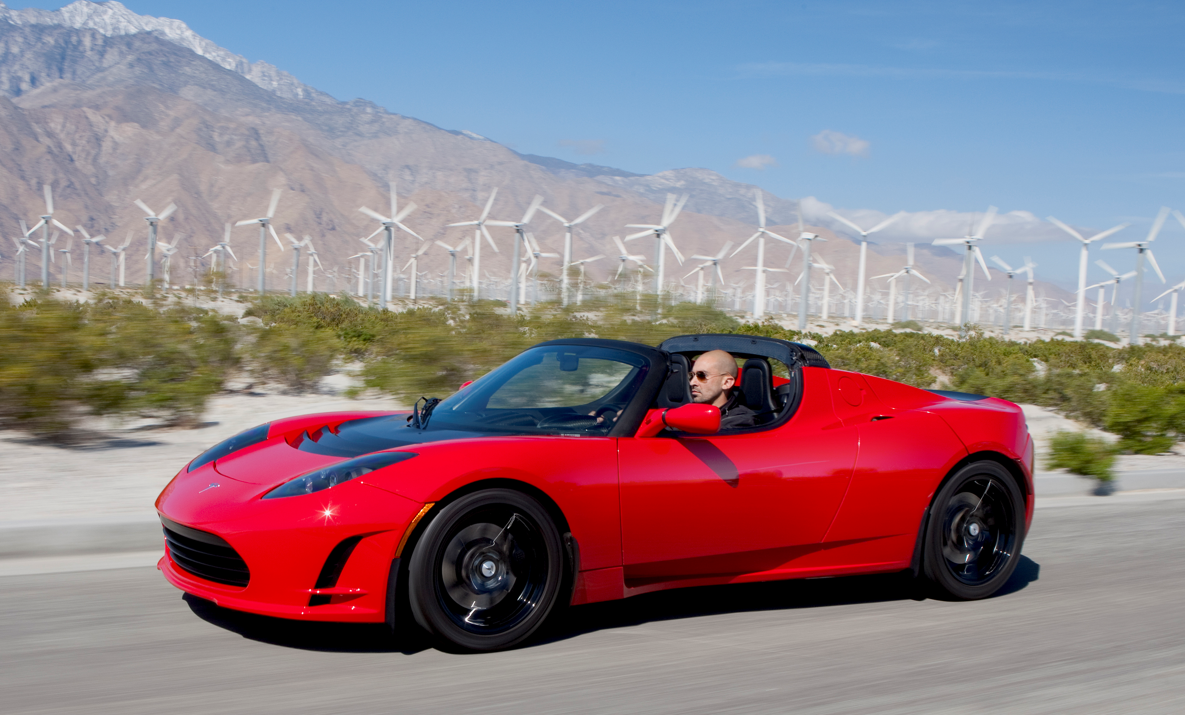
Uporablja Li-ionske baterije
ROADSTER
Prvi povsem električni športni avtomobil
Doseg: 300+ km
Prodanih več kot 2400
2008 - 2012

Slide 4
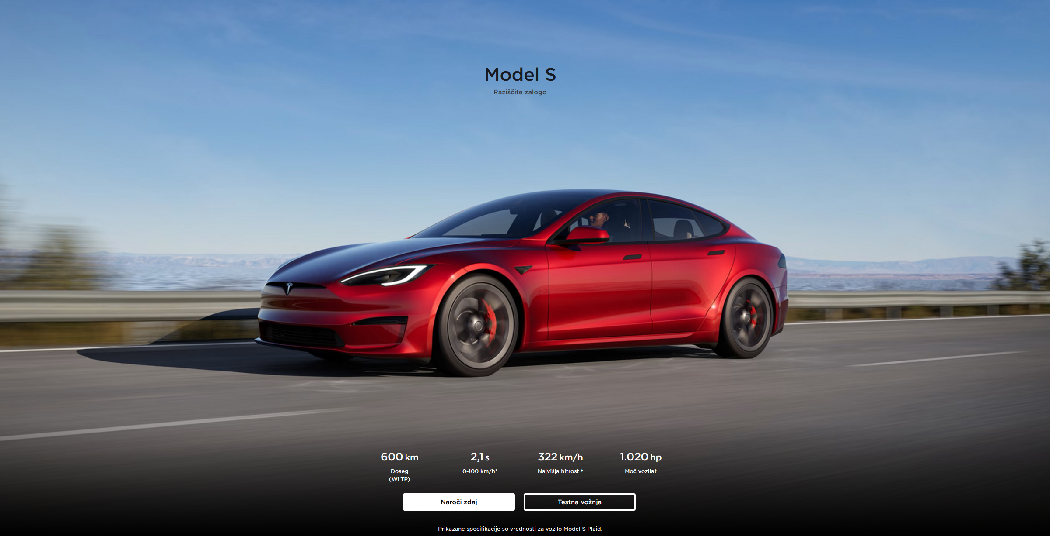
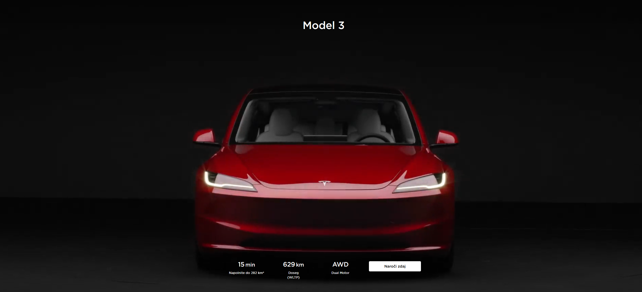
Model S

Slide 5
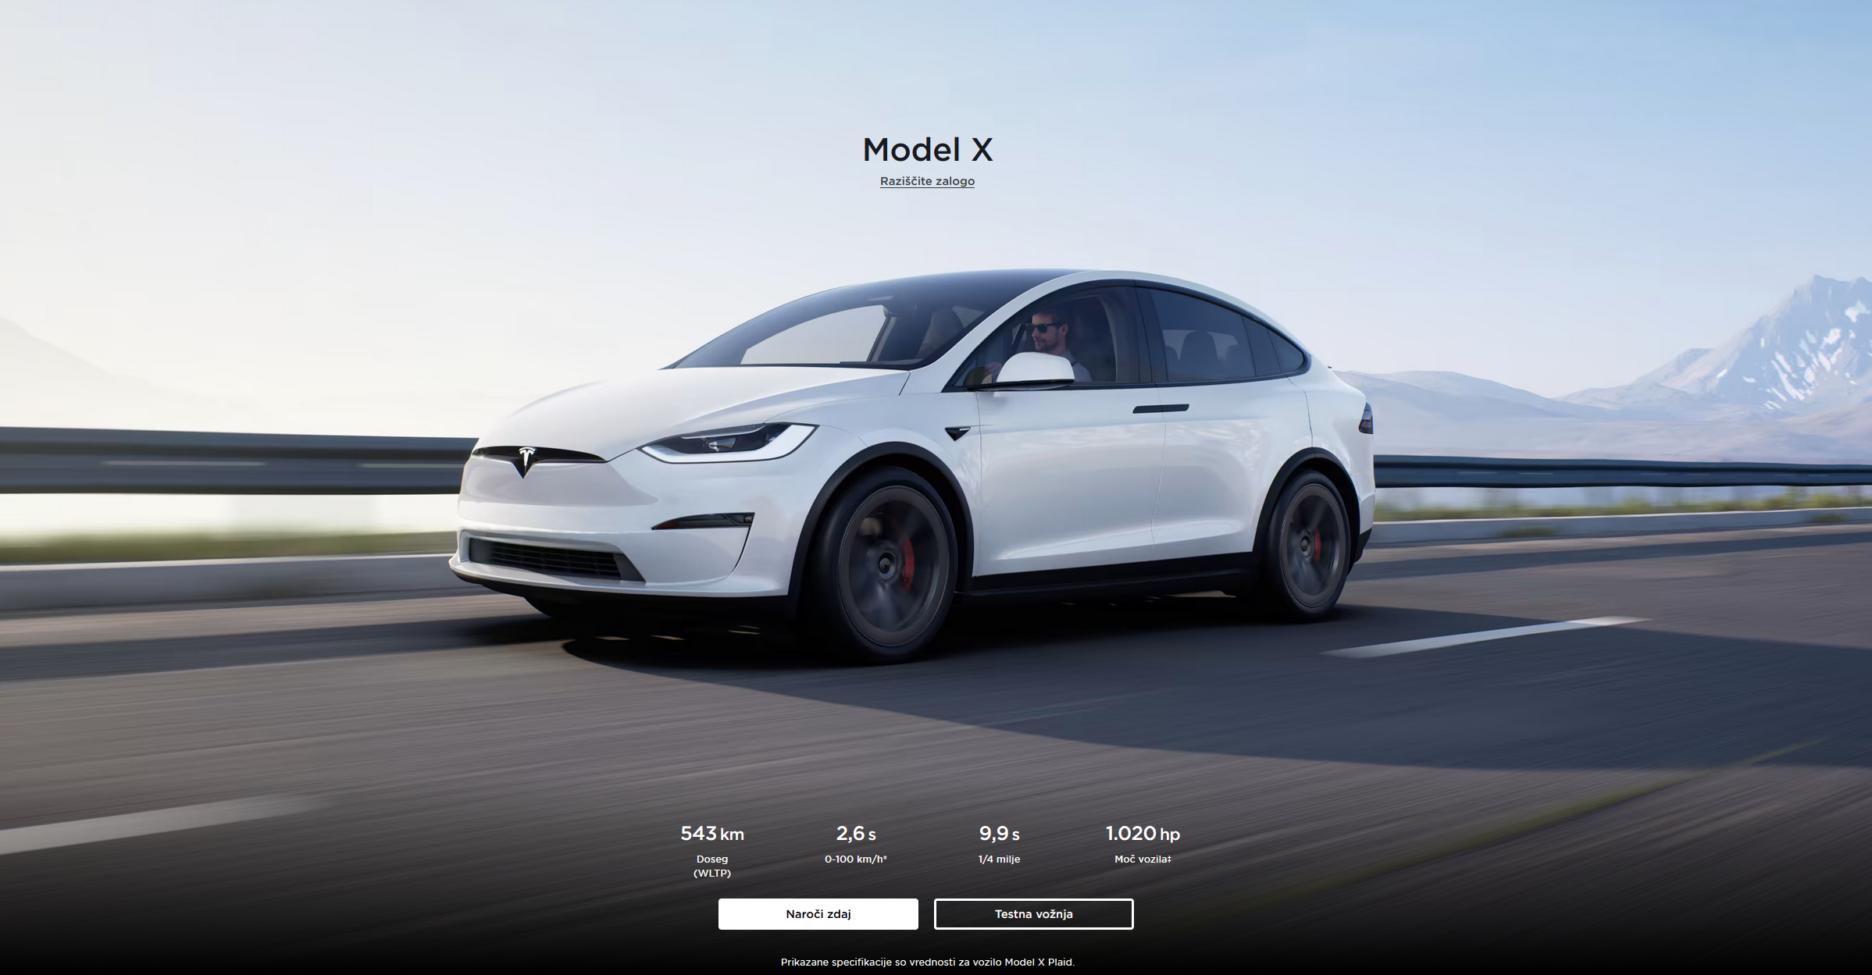
Model 3

Slide 6
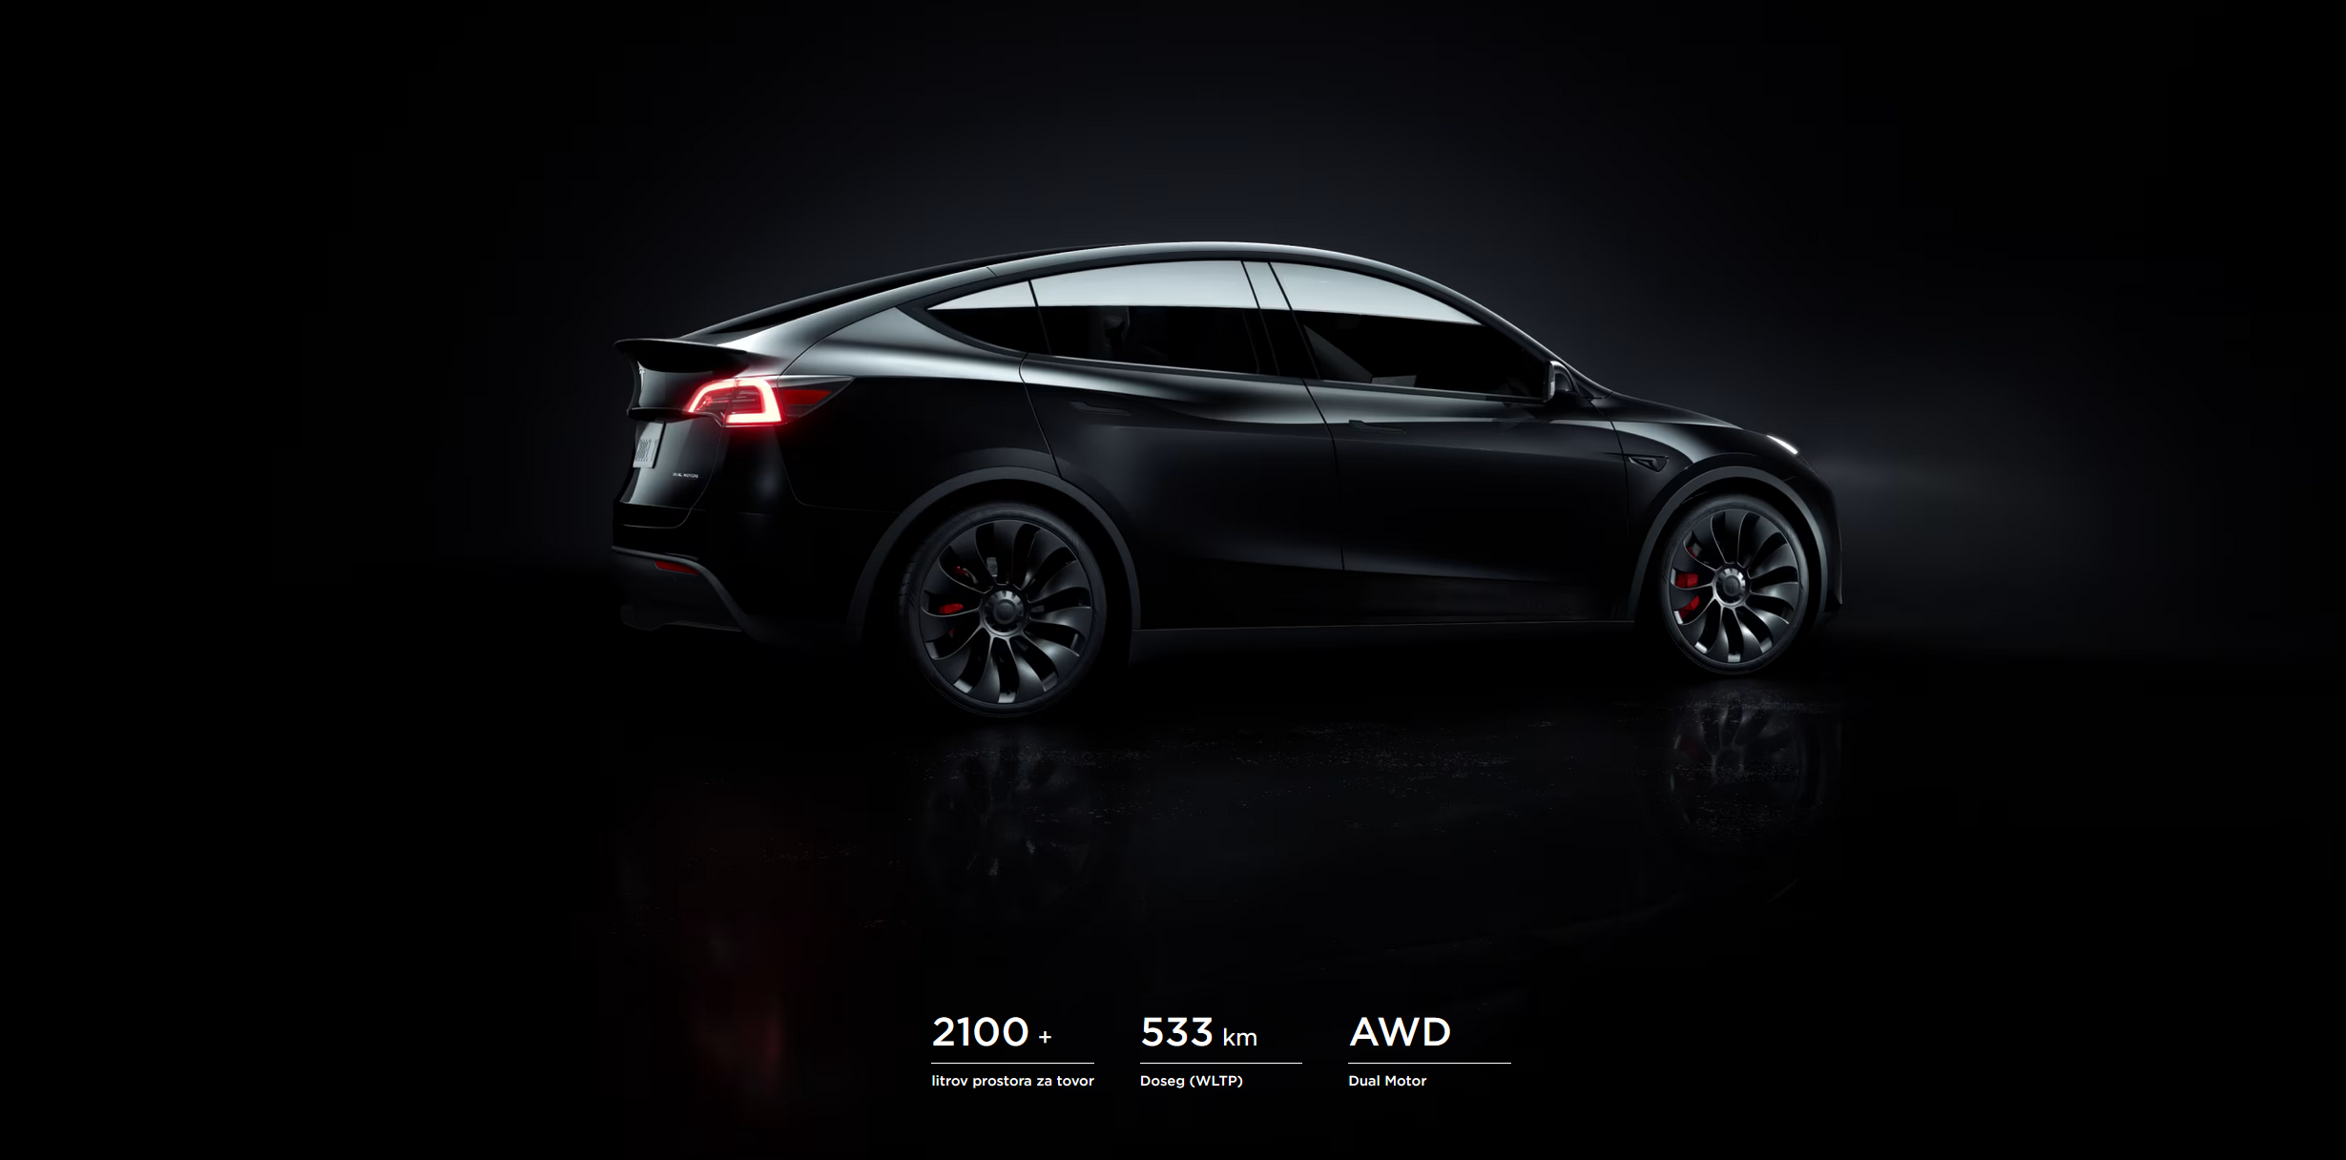
Model X

Slide 7
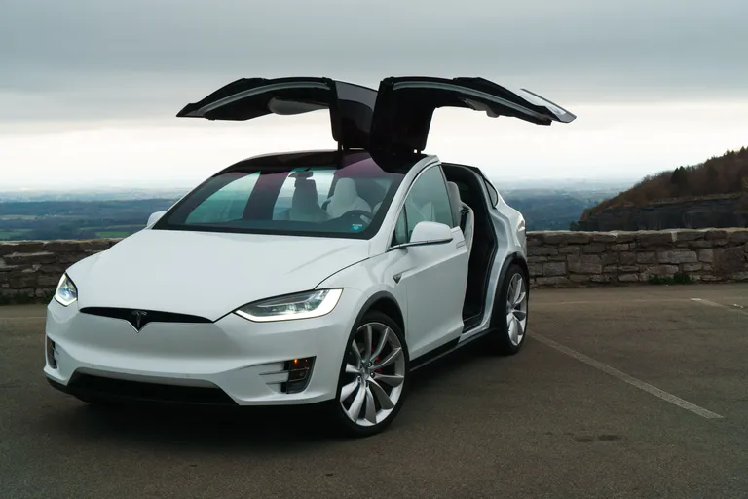
Model X

Slide 8
Model Y

Slide 9
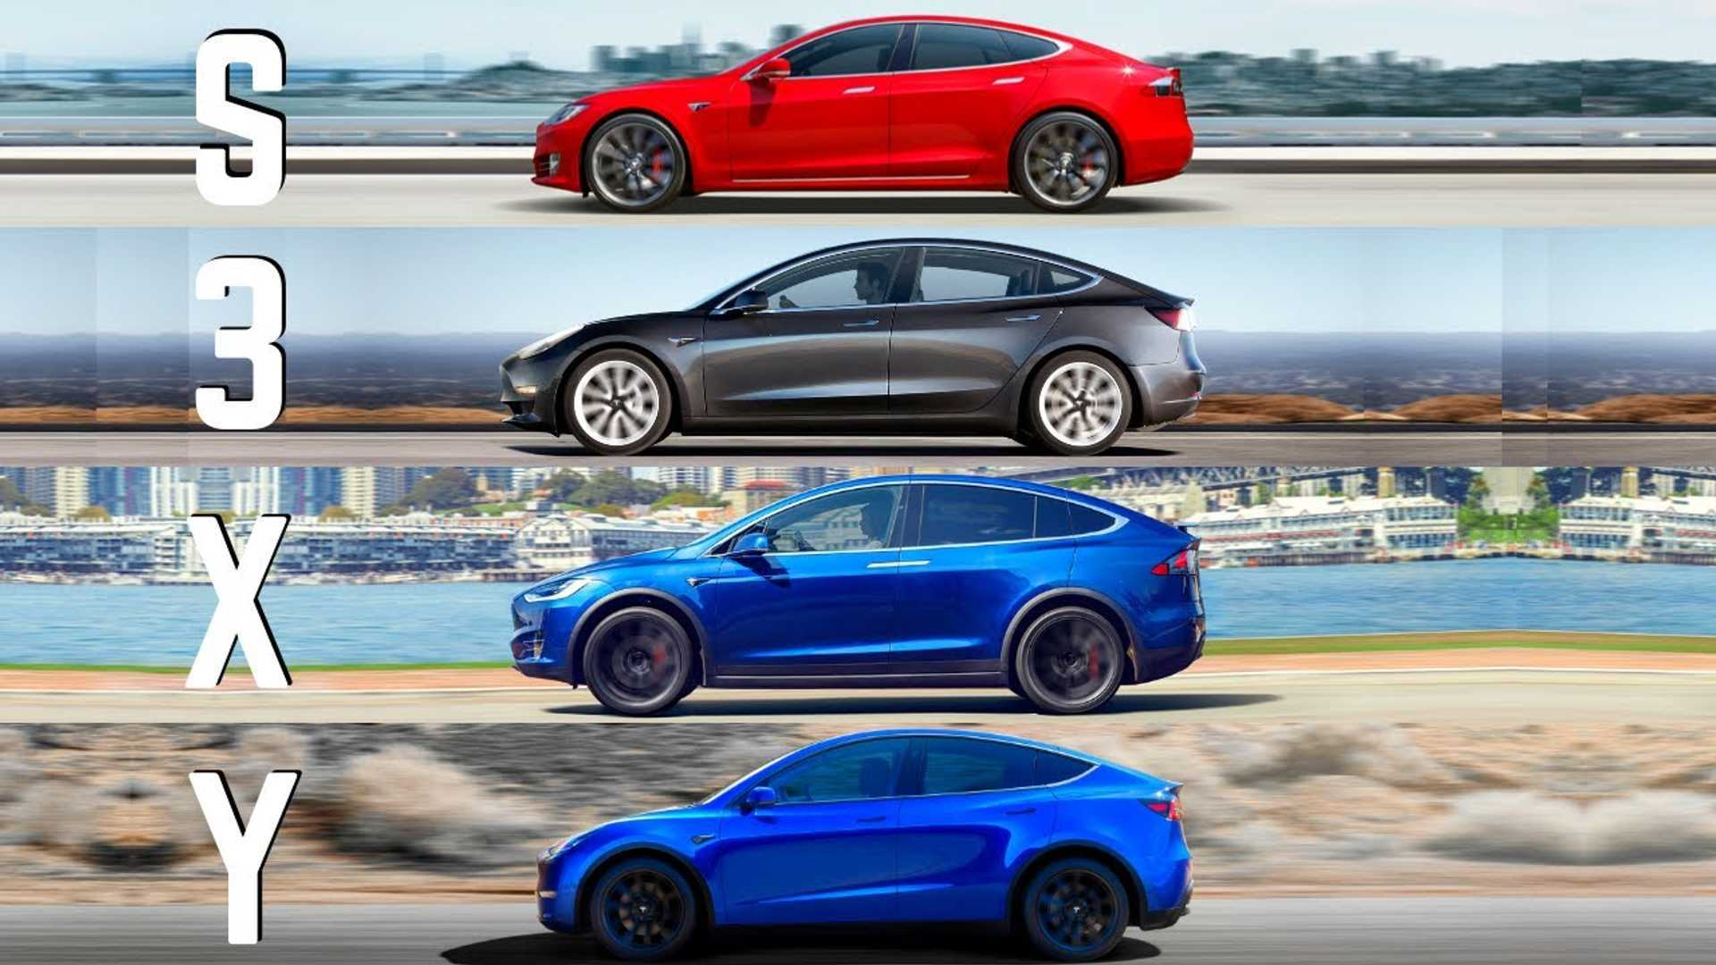
Models

Slide 10
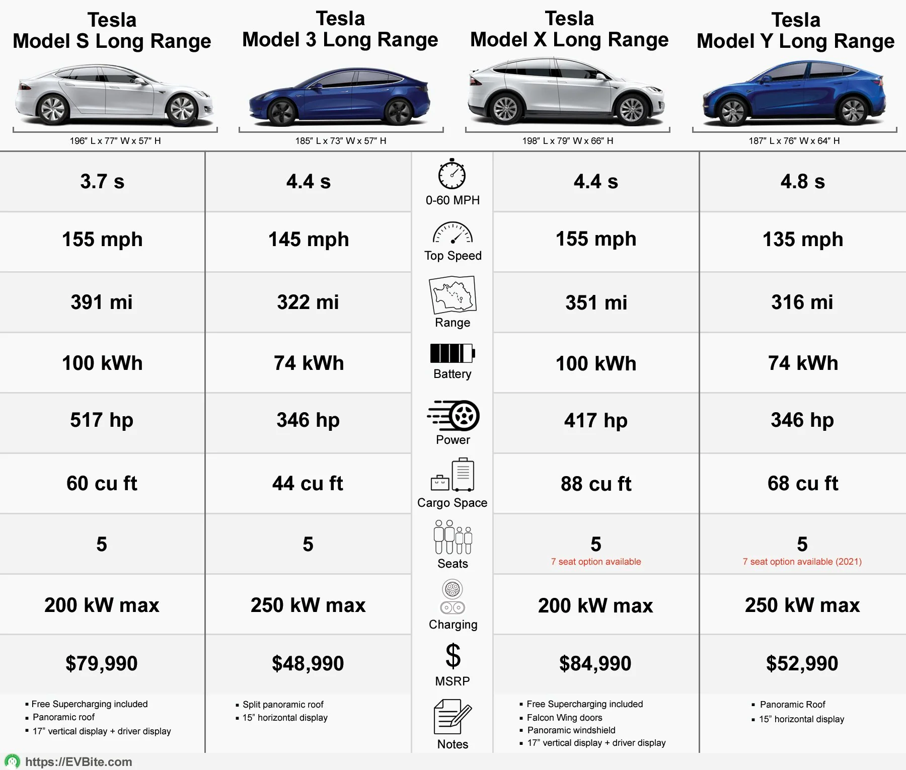
Models

Slide 11
Cybertruck
547km
4990kg towing
1400Nm
845hp
0-100: 2,7s

Slide 12
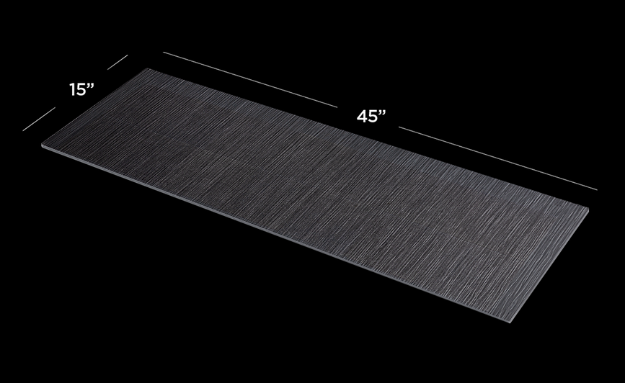
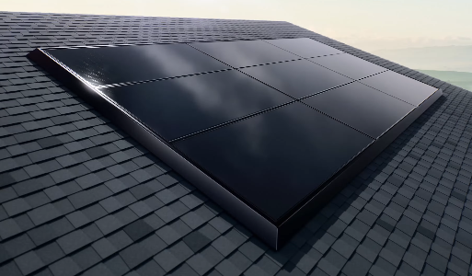

Solar Roof
480.000 roofs

Slide 13
Viri:
https://www.youtube.com/watch?v=esUb7Zy5Oio
https://www.tesla.com/
https://en.wikipedia.org/wiki/Tesla_Cybertruck
https://www.tesla.com/en_eu/cybertruck
https://www.britannica.com/topic/Tesla-Motors
https://en.wikipedia.org/wiki/Tesla,_Inc.

